Slide 1
ICT Enhancement Training:
Photo Editing

Slide 2
I. Intro To Photo Editing
Image Basics – File Formats
Image file formats are standardized means of organizing and storing digital images
Image files are composed of either pixels or vector data.
The pixel that constitute an image are ordered as a grid (columns and rows); each pixels consists of numbers representing magnitudes of brightness and color

Slide 3
* Raster/Bitmap Formats
JPEG/JFIF (Joint Photographic Experts Group)
- widely used by many… commonly used by digital cameras
- is a compression method; JPEG – compressed images are usually stored in the JFIF (JPEG File Interchange Format) file format
- JPEG compression is (in most cases) lossy compression. The JPEG/JFIF filename extension is JPG or JPEG
- when not too great, the compression does not noticeably detract from the image’s quality, but JPEG files suffer degradation when repeatedly edited and saved.

Slide 4
JPEG 2000
- JPEG 2000 is a compression standard enabling both lossless and lossy storage.
- the compression methods used are different from the ones in standard JPEG/JFIF; they improve quality and compression ratios, but also require more computational power to process.
- it is used in professional movie editing and distribution

Slide 5
Exif
- the Exif (Exchangeable image file format) format is a file standard similar to the JFIF format with TIFF extensions…
TIFF
- the TIFF (Tagged Image File Format) format remains widely accepted as a photograph file standard in the printing business. TIFF can handle device-specific color spaces, such as CMYK defined by a particular set of printing press inks.

Slide 6
Raw
- Raw refers to a family of raw image formats. These formats usually use a lossless or nearly-lossless compression and produce file sizes much smaller than the TIFF format of full-sized processed images from the same cameras.
- Raw files are so named because they are not yet processed and therefore are not ready to be printed or edited with a bitmap graphics editor
- Raw image files are sometimes called digital negative, as they fulfill the same role as negatives

Slide 7
PNG
- The PNG (Portable Network Graphics) file format was created the as the free open-source successor to the GIF
- the PNG file format supports true color (16 million colors) while the GIF supports only 256 colors.
- the lossless PNG formats is best suited for editing pictures, and the lossy formats like JPEG, are best for the final distribution of photographic images (because in this case JPEG files are usually smaller than PNG files).

Slide 8
GIF
- GIF (Graphics Interchange Format) is limited to an 8-bit palette or 256 colors. This makes the GIF format suitable for storing graphics with relatively few colors such as simple diagrams, shapes, logos, and cartoons style images.
- the GIF file format supports animation and still widely used to provide animation effects

Slide 9
BMP
- the BMP file format (Windows Bitmap) handles graphic files within the Microsoft Operation System. Typically, BMP files are uncompress, hence they are large, the advantage is their simplicity and wide acceptance in Windows programs.

Slide 10
WEBP
- new image format that uses lossy compression
- designed by Google to reduce image size to speed up webpage loading
Others:
PPM, PGM, PBM, PNM, JPEG XR, TGA, ILBM, PCX, ECW, IMG, SID, CDS, FITS, PGF, XCF, PSD, PSP
CGM, RS-274X, SVG, AI, CDR, EPS, HVIF, ODG, PDF, PGML, SWF, VML, WMF/EMF, XPS

Slide 11
Programs (Softwares)
Adobe Photoshop / Adobe Photoshop Elements
Corel Paint Shop Pro
Paint
GIMP
ACDSee Photo Editor
Ulead Photo Impact

Slide 12
Online Editors
www.freeonlinephotoeditor.com
www.glitterphoto.net
www.photocollage.net

Slide 13
Installed Applications vs. Online Editors
Installed Apps:
Pros
Offers a very wide range of editing possibilities
Has quite a handful of filter/instant effects
You could mix different processes or effects to come up with a new unique effect
Best to create competitive and professional artworks
Gives high quality images
Cons
Requires knowledge of the software and its processes
Has certain system requirements that your computer should meet

Slide 14
Installed Applications vs. Online Editors
Online Editors:
Pros
Offers fast editing with guides/instructions
Desired output can be obtained in just a few clicks
User friendly and already has a variety of templates and effects to choose from
Cons
Limited effects/templates
Limited file size
Doesn’t offer high quality images

Slide 15
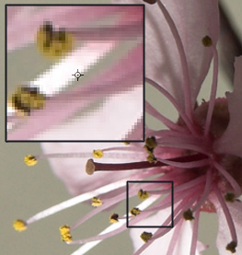
Examples of Bitmap Images

Slide 16
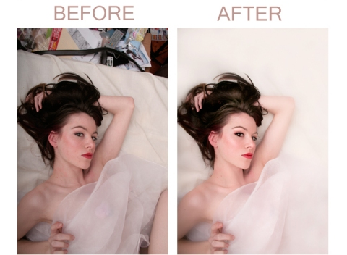
Examples of Bitmap Images

Slide 17
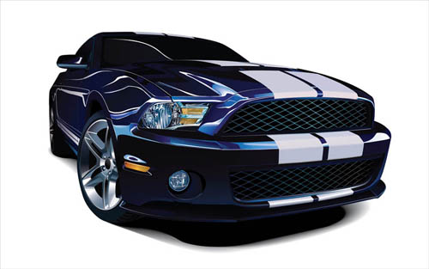
Examples of Vector Graphics

Slide 18
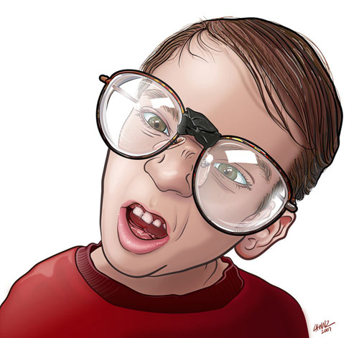
Examples of Vector Graphics

Slide 19
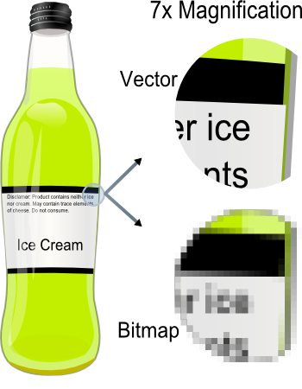
Bitmap vs. Vector

Slide 20
C. Internet Sourcing and Limitations
One of the key tasks of a graphic designer is to create or source graphics that will enhance the stated aims of each project.
When time and/or money is tight, the sourcing of images is often the first thing a designer does, rather than starting with sketches, thumbnails and plans because no matter how creative or well-intentioned, these may not be possible within the scope of the project. Customised image creation (photography, artwork, computer generated imagery etc.) is costly and time-consuming. Depending on your project, you may wish to coordinate image creation yourself, get your designer to do it or allow the designer to present you with some already existing image options.

Slide 21
However…
Images should not be taken from other projects or websites unless a copyright/usage RELEASE is in place or fair dealing/fair use could be involved to protect the publisher
Therefore…
Always check if the image you would like to download is free to use
- for display
- for reproduction
Royalties are payments made to creators every time their work is used and often apply to books sold, also to photographs or artworks published in others works.
- these types of images are usually referred to as “rights managed images”, because if you incorporate them into your project you will have to pay royalties to the creator every time you go to print.

Slide 22
I. Photo Editing Basics
Software Interface
Parts/Interface
- Menu Bar
- Image Window
- Toolbox
- Status Bar
- Palettes

Slide 23
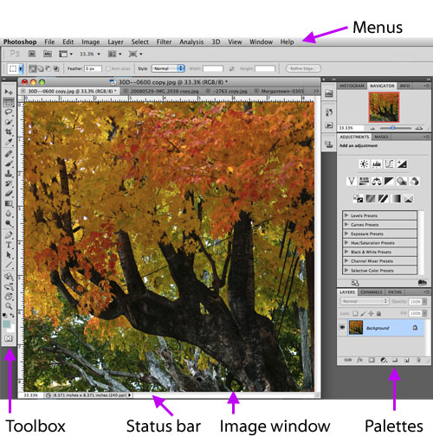

Slide 24
Components of the Photoshop desktop include the menu bar, image window, toolbox, status bar, and palettes.
The Menu Bar
The menu bar, at the top of the Photoshop desktop, includes several dropdown menus for choosing commands. Right below the menu bar, options for the currently-selected tool are displayed.

Slide 25
Image Window
The image window displays the current image. The name of the image file appears at the top edge of the image window. If rulers are turned on, they appear at the top and left edges of the image window. To display or hide rulers, choose Ctrl-R or View>Rulers.
About Rulers: Rulers show the size of your image. To change the unit of measurement (such as from pixels to inches), double click on the ruler, or go to Preferences (Edit>Preferences>Units & Rulers). If you are creating an image for the Web, use pixels as the unit of measurement.

Slide 26
The Toolbox
The toolbox contains tools for working with images in Photoshop. Only one tool is selected at any given time. To select a tool, click on its icon in the toolbox.
The Status Bar
The status bar at the bottom of the Photoshop desktop provides information about your current view and other information that you can specify by choosing from a dropdown menu (in this example, the view is now 33.33% and the document dimensions are 8.371" x 8.371").

Slide 27
Palettes
Palettes enable you to perform a wide variety of tasks in Photoshop. To display or hide particular palettes, go to the Window menu and choose a palette name.
Palettes are usually organized into groups. In the above example, Layers, Channels, and Paths are a group. You can easily move a palette group by dragging its blue bar (at the top of the group). To shrink a palette group, double-click on its blue bar. To hide a palette group, click its close box (the "X" on the right side of the blue bar).
You can drag the tabs of palettes to move them around, or to combine them into other groups.
To reset palette locations to the default, choose Window>Workspace>Reset Palette Locations.

Slide 28
Moving Around an Image
- Zoom Tool
- Hand Tool
- Navigator Palette

Slide 29
When editing images, you can do many tasks more effectively if you zoom in and move around the image. Zoom in close to make adjustments to small areas, then zoom back out to see how your edits have affected the overall image.
The main tools for zooming and moving around an image are the zoom tool, the hand tool, and the navigator palette.
To zoom in, choose the Zoom tool ( ) and then click or click and drag in the image.

Slide 30
When you zoom in, the zoom percentage (or view size) increases. The current zoom percentage is shown in the status bar and at the top of the image window. The zoom percentage shows the magnification at which you are viewing the image (not the actual size of the image).
A quick way to go to 100% view size is to double-click on the zoom tool icon in the toolbox.
To zoom out, press the ALT key while you click with the zoom tool.

Slide 31
Use the Hand tool ( ) to move around the image in the window when you are zoomed-in.
When using another tool, you can press the spacebar to temporarily access the hand tool. You can then drag to move around the image. When you stop pressing the spacebar, you will return to using the other tool.

Slide 32
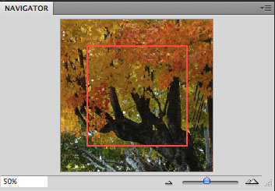
To zoom and move around the image with the Navigator palette, choose Window>Show Navigator. The navigator palette will appear:
Use the navigator palette to zoom in or out of an image (by dragging the navigator slider) or to move around the image by dragging the view box (when you are zoomed in). The view box (red box in the above example) shows the part of the image that is currently being displayed in the main image window.

Slide 33
B. Opening Files
- File Menu > Open
or create a new document:
- File Menu > New

Slide 34
C. Imaging Concepts
Image Size, Resolution, Print Size
Color Mode
- RGB (3 channels, for screen presentations and web
- Grayscale (1 channel, with 256 shades of gray)
- Bitmap Mode (1 channel, with only b&w color)
- Indexed (1 channel, with 256 colors, for web)
- CMYK (4 channels, used by printing firms)

Slide 35
Digital images are made up of pixels (picture elements), which can be defined as colored squares. Each pixel is only one color.
A good way to learn about image size, resolution, and print size is to experiment with an image using the Image Size dialog box. To do this, open an image in Photoshop. Then choose Image > Image Size, and the Image Size dialog box appears.

Slide 36
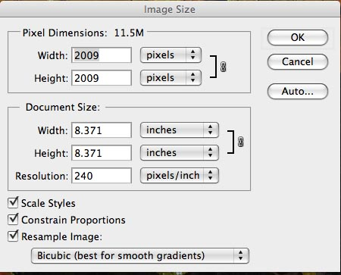
Under Pixel Dimensions, Width and Height refer to the number of pixels in an image, which has to do with the size of display on screen.
Under Document Size, Width and Height refer to the size of the image when printed.

Slide 37
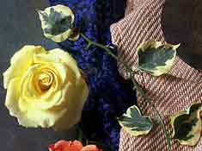
RGB mode
three channels (Red, Green, and Blue)
used by all monitors and by the Web

Slide 38
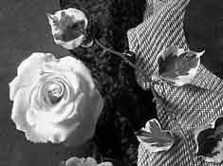
Grayscale mode
One channel, 256 shades of gray

Slide 39
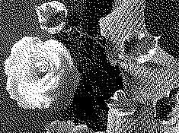
Bitmap mode
black and white (no shades of gray)
used for line art

Slide 40
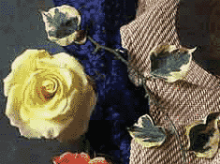
Indexed mode
one color channel, up to 256 color values
used for GIF images destined for the Web

Slide 41
CMYK mode
four channels (Cyan, Magenta, Yellow, Black)
used by professional printing houses. If you are producing a images for a publication or poster, you may need to save it in CMYK mode.

Slide 42
D. Editing Images
Cropping
Adjusting Contrast (Levels)
Color Correction (Auto Color, Color Balance)
Removing Imperfections (Clone Stamp, Healing Brush)
Sharpening

Slide 43
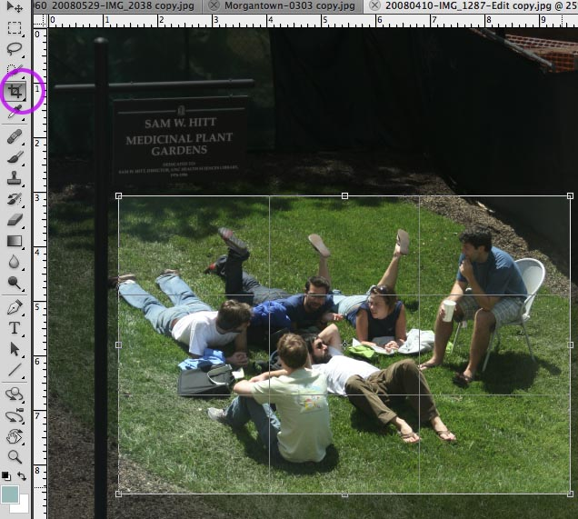
Cropping
Choose the Crop tool ( ) in the toolbox. Then click and drag across the image. An outline will appear that shows you the area to be cropped.

Slide 44
Adjust the area to be cropped by using handles on the edges of the image.
Note: If you move the cursor just outside of one of the corner handles, it turns into a curved cursor, which then allows you change the alignment of the selected area. This is useful, for example, to correct a scan of a picture that was in a crooked position on the scanner.
Press Enter to crop or Escape to cancel

Slide 45
Adjusting Contrast
The Levels command (Image>Adjust>Levels) is an excellent tool for adjusting contrast. The Levels dialog box displays a histogram of the brightness values of the pixels in your image. There are two sets of sliders (triangles): input levels and output levels. For most editing tasks, use the input levels sliders (the three triangles just below the histogram).

Slide 46
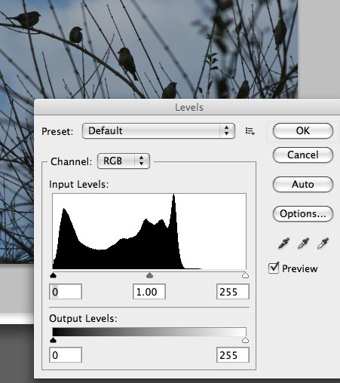
Adjusting Contrast
The Levels command (Image>Adjust>Levels) is an excellent tool for adjusting contrast. The Levels dialog box displays a histogram of the brightness values of the pixels in your image. There are two sets of sliders (triangles): input levels and output levels. For most editing tasks, use the input levels sliders (the three triangles just below the histogram).

Slide 47
To increase contrast (create more dark and light pixels): Move the left and right sliders toward the middle.
To adjust the midtones: Move the middle input levels slider to the left to lighten midtones, and move the middle slider to the right to darken the midtones.
Keep the Preview box checked in order to see the effects of moving the sliders on your image.
To make the adjustment, click OK. To cancel it, click Cancel.

Slide 48
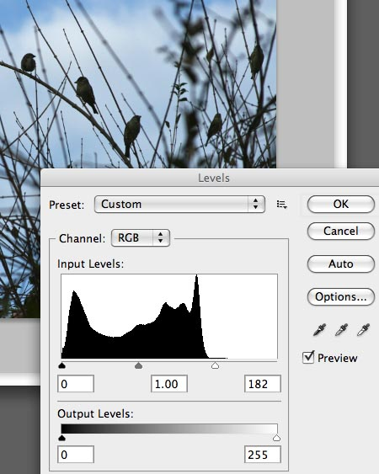
On the example at the left, there are few (if any) pixels that are white or even light gray. By moving the right slider towards the middle, we can lighten image to correct the exposure. Because the Preview box in the layers palette is checked, we can see the result on our image as we adjust the sliders.

Slide 49
Color Correction
Often you may need or want to change the balance of color in an image. For example, a photo take outdoors may look too blue, or a photo taken indoors may look yellow or orange.
There are several ways to adjust color, many of which are under Adjustments in the Image menu, including Color Balance, Color Mixer, and Photo filters. These tools are easy to use and the best way to learn about them is to open a practice image and choose one of these commands, and experiment with the settings in the dialog box that appears for the command.

Slide 50
Auto Color
The easiest color correction tool is Auto Color. Auto Color often (though not always) gives very good results. Auto Color attempts to color correct images automatically by analyzing the highlights, shadows, and midtones of each channel.

Slide 51
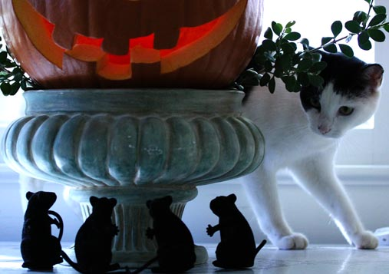
Choose Image>Auto Color to use the Auto Color command and see if you like the results.
The following is an example of an image before Auto Color was applied. The image is good but slightly more blue than I would prefer:

Slide 52
The following is the image after applying Auto Color. The difference is subtle, but Auto Color added a little warmth to the image.
BEFORE
AFTER

Slide 53
Using the Clone tool
The clone tool ( ), also called the rubber stamp, allows you to remove imperfections such as dust and scratches by covering them with samples of nearby pixels. For best results, zoom in close and use a small brush.
1. Zoom in close to the area you want to edit.
2. Choose the clone tool, and make sure "aligned" is checked in the Options bar.

Slide 54
3. In the options bar, choose a brush size (this determines the size of the sample). The cursor shows the size of the brush, as shown below. The circle is the cursor (brush).
(Note: if the cursor doesn't show the brush size, go to Edit>Preferences>Display & Cursors, and choose Brush Size for Painting Cursors.)

Slide 55
4. Alt-click to define initial source point (sample). In the above example, I Alt-clicked where the cursor is shown.
5. Move the cursor over the area you want to cover, and click to cover it with the sample. In the following example, I moved the cursor slightly down and to the left to cover several white specks. You can see that the imperfection has been removed (there is a slight blemish where the clone tool was applied, but it is a vast improvement).

Slide 56
Using the Healing Brush Tool
The steps for using the healing brush tool ( ) are the same as for the clone tool. The healing brush attempts to take the texture from the sample without affecting the brightness of the area to which it is applied. In some cases this is more effective than the clone tool. The following is shows the same correction as above, only this time done with the healing brush tool. The blemish appears to be somewhat less noticeable

Slide 57
Sharpening
Use Filter > Sharpen > Unsharp Mask to sharpen an image. In the dialog box that appears, keep the preview box checked. This allows you to see the effects of different settings.

Slide 58
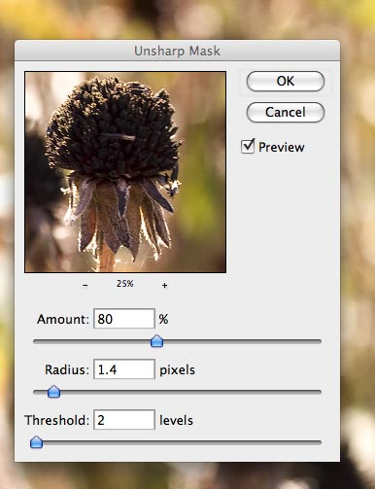
Amount -- How much sharpening is applied. Consider using a value between 50% and 150% for typical images.

Slide 59
Radius -- The number of pixels affected around edges. Consider using a value between 0.2 and 2.0.

Slide 60
Threshold -- Defines what brightness difference qualifies as an edge (0 is default, sharpens all pixels). Consider using a value somewhere between 1and 5 (for Threshold, the higher the value, the less pronounced the sharpening effect).

Slide 61
E. More Image Editing
Selection Techniques
- Marquee Tools (Rectangular, Elliptical)
- Lasso Tools (Lasso, Polygonal, Magnetic)
- Magic Wand
Feathering Selections
Working with Layers
Adding Text (Type Tool)
Painting

Slide 62
In some cases, you may wish to isolate part of an image for editing, or to combine it with other images. In Photoshop, this is called a selection. When part of an image has been selected, the image editing tools and commands work the same way, but only the selected part of the image is affected.
When you make a selection, the part of the image that is protected (that is, not selected) is sometimes referred to as a mask. Just as you might use masking tape to protect part of a wall when you are painting a room, in Photoshop you are masking the part of the image that you want to protect when you have selected part of an image for editing.

Slide 63
When you make a selection, a selection outline appears to show you the selected area. In the following example, a rectangular area has been selected:

Slide 64
Selecting Rectangles and Ellipses: the Marquee tools
The Rectangular Marquee tool ( ) is probably one of the most frequently used selection tool. It allows you to select rectangular areas. Click and drag diagonally with it to make a selection.
The elliptical marquee tool usually hidden "behind" the rectangular marquee tool. To select an elliptical area, right click on the rectangular marquee tool and select the Elliptical Marquee tool ( ). Then drag (with Elliptical tool)

Slide 65
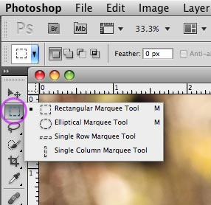
Selecting Rectangles and Ellipses: the Marquee tools

Slide 66
Selecting Irregularly Shaped Areas: the Lasso Tools
To create freeform selections, you can click and drag with the Lasso tool ( ). But the lasso tool may not give you enough control. For more control, you may find the polygon lasso and magnetic lasso tools easier to use.

Slide 67
The Polygon Lasso tool ( ) is often quite useful for selecting irregularly shaped areas. To use it, click on the image, then move to another place and click again to create a segment. Click multiple times to create a selection around an irregular area in your image. Double-click to finish the selection. Note: If you are in the middle of selecting and you make a mistake, press the backspace key to go back one segment, or click the Esc key to undo the selection entirely.

Slide 68
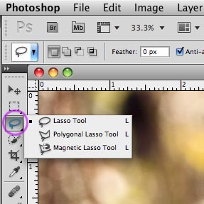
Without pressing the mouse button, move the magnetic lasso tool around an area to select it. The tool will look for edges. You can adjust its sensitivity to edges in the options bar.

Slide 69
Selecting by brightness and color: Magic Wand tool (W)
Click somewhere on the image with the magic wand tool to select adjacent portions of the image based on color brightness. The higher the tolerance entered in the Options palette, the more pixels are selected.

Slide 70
General Selection techniques
To invert a selection, choose Select > Inverse. Everything that was selected becomes masked, and everything that was masked now becomes the selection.
To deselect, click outside of the selection, or choose Select > Deselect.
You can also save a selection (Select > Save Selection) for later use (Select > Load Selection).

Slide 71
Adding to and subtracting from current selections
To add to an existing selection, press Shift
To subtract from an existing selection, press Alt
To add to an existing selection based on color, choose Select > Similar.

Slide 72
Moving and Cloning Selections
To move a selection outline, put the selection cursor inside the selected area and drag.
To move the contents of a selection, choose the move tool and drag the selection.
To clone a selection, press Alt while using the move tool .

Slide 73
Saving Selections for Later Use
To save a selection for later use, choose Select > Save Selection. The active selection will be saved, and you will be prompted to give it a name.
To load a saved selection, choose Select >Load Selection.

Slide 74
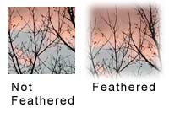
Feathering Selections
Feathering gives a selection a softer edge. You can feather a selection by entering a value in the Feather checkbox in the options bar. Or you can feather an existing selection by choosing Select > Feather.
During cases when Feather is not present at the Select Menu, you may, on the other hand, activate it via shortcut key which is:
Ctrl + Alt + D =
for Photoshop 7, CS, CS2, and CS3
Shift + F6 =
for Photoshop CS4 and CS5

Slide 75
Images in Adobe Photoshop are made up of layers. Initially, each image has only one layer (called the background layer), but you can add more layers to the image.
Layers are very useful for editing images and creating special effects. For example, you could make a copy of a layer and make some changes to it.
If you don't like the results, you can delete the layer and still have your original layer as a backup. You can also combine images by putting different content on different layers.

Slide 76
Note:
Keep in mind that layers require a substantial amount of memory. Photoshop files with large numbers of layers typically are large files.

Slide 77
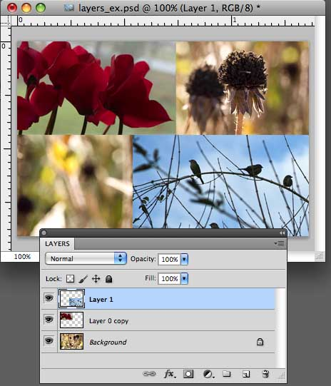
To work with layers, display the Layers palette by choosing Layers from the Window menu. The following is an example of the layers palette along with an image.

Slide 78
The first column of the layers palette shows which layers are currently visible, indicate by the eye icon ( ). In the above example all the layers are visible. You can change a layer's visibility by clicking in the first column for the layer.
Note: Even when a layer is visible, part of it may be transparent. For example, this happens if you select part of an area and then press the delete key. When part of a layer is transparent, the layers underneath it can show through.
Photoshop represents transparent areas by a checkerboard pattern:

Slide 79
You can change the opacity of a layer by entering a value between 0 and 100 in the Opacity field at the top of the layers palette. For example, at an opacity of 10%, the layer would be nearly transparent; at an opacity of 90%, it would be almost completely opaque. The opacity default is 100%.
Editing you do within Photoshop affects the current layer. In the example above, "Layer 1" is the current layer.
To make a layer the current layer, click on the layer in the Layers palette.
To change the name of the layer, double-click on the layer's name, then type in a new name.

Slide 80
To lock (prevent changes to) a layer, click one of the Lock: boxes near the top of the layers palette.
From left to right, they are:
lock transparent areas,
lock pixels (prevent changes to non-transparent areas),
lock layer position,
and lock all.

Slide 81
Other actions can be performed by clicking on icons at the bottom of the layers palette:

Slide 82
To link two or more layers, first select them by shift-clicking on them in the layers palette. Then click the link layers icon. When they are linked they move together, so if you reposition a layer you will simpultaneously reposition all layers linked to it.
To add effects to a layer (for example, shadows), click on the layer styles icon.

Slide 83
To add an adjustment layer, click the Adjustment layer icon (adjustment layers are discussed below).
To create a new layer, click the new layer icon at the bottom of the Layers palette, or duplicate a layer by dragging the layer to the new layer icon.
To delete a layer, click the trash icon, or drag the layer to the trash icon (next to the new layer icon).

Slide 84
Adding Text
To add text to images use the Type tool ("T" in the Toolbox).
To enter a single line of text, click on the image with the type tool. Then type. A type layer is automatically created.
To create a paragraph (column) of text, click and drag with the type tool, then start typing. When you enter the text, it will wrap at the point where you stopped dragging.
To reposition the text while you are using the Type tool, press the Ctrl key.The Type will change into the move tool so you can move the text box.

Slide 85
When you are finished typing, click the check mark in the options bar.
To cancel, click the X mark in the options bar.
To adjust the color and format of your type, select the type and then change the settings in the options bar (at the top of the Photoshop desktop),

Slide 86
When you use the Type tool, a type layer is automatically created. As long as your type is on a Type layer it is editable. If you convert it to an image layer by rasterizing it (Layer>Rasterize), you will no longer be able to edit it.

Slide 87
Painting with the Paint Brush Tool
To paint in Photoshop, click Paint Brush Tool ( ) at the Toolbox/Tools Palette
You can change the brush type and brush size by choosing among the selection from the Brush Preset Picker found at the options bar:

Slide 88
Change colors of the brush by selecting among the colors found at the Swatches Palette:
If the swatches palette is not visible, enable it by selecting if from the Menu Bar > Windows > Swatches

Slide 89
Exporting/Saving your Project
How often?
Which file type should I use?

